Slide 1
Z. Gu
Embedded Systems with ARM Cortex-M Microcontrollers in Assembly Language and C
Chapter 4
ARM Arithmetic and Logic Instructions
Exercises ANS
Fall 2025
Acknowledgement: Lecture slides based on Embedded Systems with ARM Cortex-M Microcontrollers in Assembly Language and C, University of Maine https://web.eece.maine.edu/~zhu/book/

Slide 2
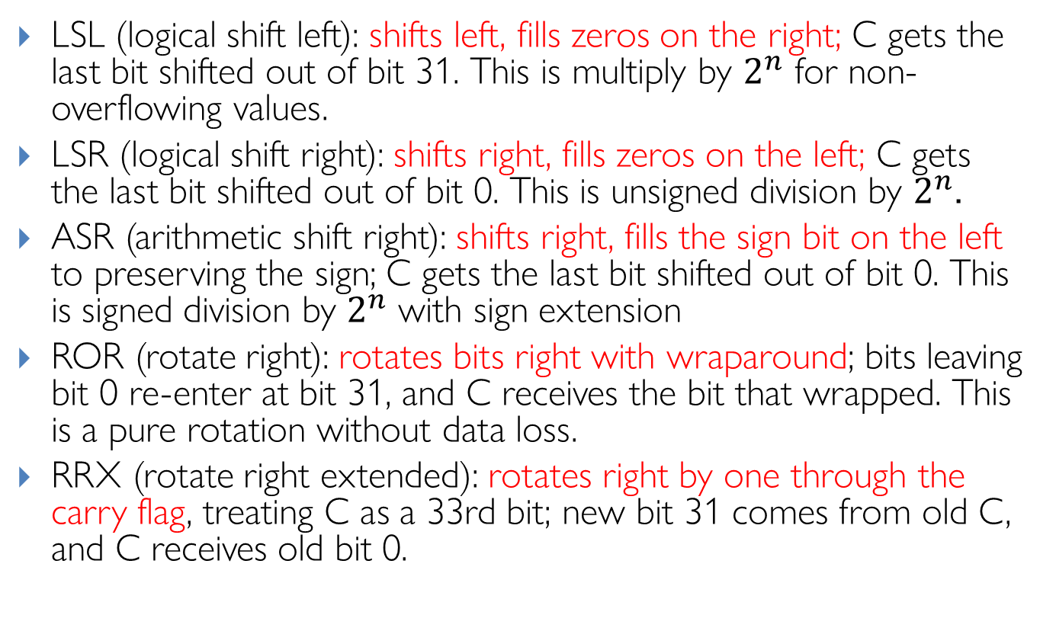
Barrel Shifter: Explanations
Review
LSL (logical shift left): shifts left, fills zeros on the right; C gets the last bit shifted out of bit 31. This is multiply by $2^{n}$ for non-overflowing values.
LSR (logical shift right): shifts right, fills zeros on the left; C gets the last bit shifted out of bit 0. This is unsigned division by $2^{n}$.
ASR (arithmetic shift right): shifts right, fills the sign bit on the left to preserving the sign; C gets the last bit shifted out of bit 0. This is signed division by $2^{n}$ with sign extension
ROR (rotate right): rotates bits right with wraparound; bits leaving bit 0 re-enter at bit 31, and C receives the bit that wrapped. This is a pure rotation without data loss.
RRX (rotate right extended): rotates right by one through the carry flag, treating C as a 33rd bit; new bit 31 comes from old C, and C receives old bit 0.
Notes:
Useful for multiword shifts and certain crypto/bit-manip patterns
LSR (used here): Always fills with zeros, converting the negative value to a large positive number
ASR: Would preserve the sign bit, maintaining the negative value (-4096)

Slide 3
Arithmetic with Shifts
Assuimg 32-bit registers:
Q1:
LDR r0, =0x00000007
MOV r0, r0, LSL 7
Q2:
LDR r0, =0x00000400
MOV r0, r0, LSR 2
Q3:
LDR r0, =0xFFFFC000
MOV r0, r0, LSR 2
Q4:
LDR r0, =0xFFFFC000
MOV r0, r0, ASR 2
Q5:
LDR r0, =0x00000007
MOV r0, r0, ROR 2

Slide 4
Q1 ANS
Q1:
LDR r0, =0x00000007
MOV r0, r0, LSL 7
ANS:
Original r0 = 0000 0000 0000 0000 0000 0000 0000 0111
After LSL r0 = 0000 0000 0000 0000 0000 0011 1000 0000 = 0x0380 (896 in decimal)
In decimal: 7 × 2^7 = 7 × 128 = 896 (Not required for exam)

Slide 5
Q2 ANS
Q2:
LDR r0, =0x00000400
MOV r0, r0, LSR 2
ANS:
Original r0 = 0000 0000 0000 0000 0000 0100 0000 0000
After LSR r0 = 0000 0000 0000 0000 0000 0001 0000 0000 = 0x00000100 (256 in decimal)
In decimal: 1024 ÷ 2² = 256 (Not required for exam)

Slide 6
Q3 ANS
Q3:
LDR r0, =0xFFFFC000
MOV r0, r0, LSR 2
ANS:
Original r0 = 1111 1111 1111 1111 1111 1100 0000 0000
After ASR r0 = 0011 1111 1111 1111 1111 1111 0000 0000 = 0x3FFFF000
In decimal: 4,294,951,424 ÷ 4 = 1,073,737,728 (Not required for exam)

Slide 7
Q4 ANS
Q3:
LDR r0, =0xFFFFC000
MOV r0, r0, ASR 2
ANS:
Original r0 = 1111 1111 1111 1111 1111 1100 0000 0000
After ASR r0 = 1111 1111 1111 1111 1111 1111 0000 0000 = 0xFFFFFF00 (-256 in decimal)
In decimal: -16384 ÷ 2² = -4096 (Not required for exam)

Slide 8
Q5 ANS
Q4:
LDR r0, =0x00000007
MOV r0, r0, ROR 2
ANS:
Original r0 = 0000 0000 0000 0000 0000 0000 0000 0111
After ROR r0 = 1100 0000 0000 0000 0000 0000 0000 0001 = 0xC0000001

Slide 9
Assembly Programming
Write ARMv7 assembly for pseudocode
r1 = (r0 >> 4) & 15

Slide 10
Assembly Programming ANS
Write ARMv7 assembly for pseudocode
r1 = (r0 >> 4) & 15
ANS:
MOV r1, r0, LSR #4
AND r1, r1, #15
Notes:
Alternative solution:
AND r1, r0, #0xF0
MOV r1, r1, LSR #4

